Slide 1
Unit 3
Lecture 2

Slide 2
Estimating the degradation function(H)
3 ways to estimate
Observation
Experimentation
Mathematical modelling
The process of restoring an image by using a degradation function that has been estimated in some of the ways mentioned above is called the blind deconvolution.
Called blind as the estimation of the degradation function we get is an approximation.
It is not the actual degradation that has taken place

Slide 3
Observation
Suppose you are given a degraded image without any knowledge about H
One way to find H is by observation of the image itself.
For e.g. if the image is blurred, observe the image containing sample structures, like part of an object or background
Looking at the image we identify a region in the image which is having some simple structure
Identify such a subimage g_{s}(x,y)
You have the estimated image f_{s}(x,y)
G_{s}(u,v) is the FT of the sub image
F_{s}(u,v) is the FT of the estimated image

Slide 4
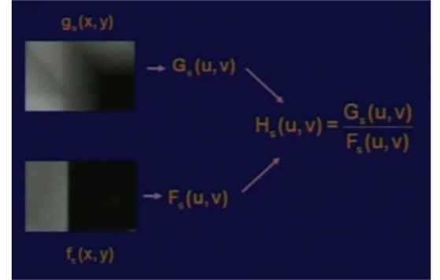
Gs(u,v) is the FT of the sub image
Fs(u,v) is the FT of the estimated image
So H is given as
g_{s}(x,y)
G_{s}(u,v)
H_{s}(u,v)
f_{s}(x,y)
F_{s}(u,v)

Slide 5
Experimentation:
Images similar to the degraded image is acquired using the same imaging device setup
Using various system settings the image close to the degraded image is estimated
Next we have to find the response of the imaging device to an impulse
Image the impulse (a small dot of light)
Impulse is simulated by a small dot of bright light
Then FT of the impulse and the impulse image is found
From these two quantities H is found
The intensity of the impulse falling on the camera must be so high that the effect of noise is reduced.

Slide 6
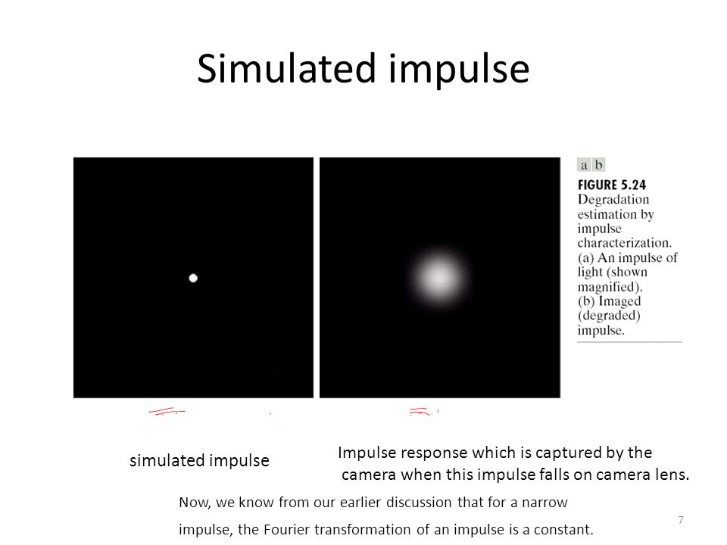

Slide 7
FT constant for a narrow impulse
G(u,v) is the FT of the observed image
Constant A represents the strength of the impulse.

Slide 8
Mathematical Modelling
Deduce mathematical model from basic principles
e.g. model for measuring atmospheric turbulence which will cause the degradation
K is a constant and gives the nature of turbulence
By varying the values of k different degraded images obtained
K is large :very strong turbulence
K is small: mild turbulence

Slide 9
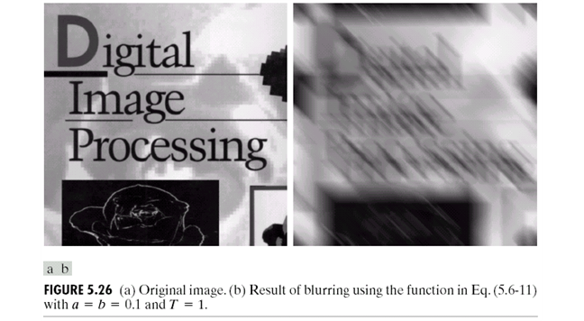
Equation derived for motion blur

Slide 10
Restoration of images degraded by degradation function in frequency domain
Inverse filter: direct inverse filtering
Simply by dividing the FT of the degraded image with the FT of the degradation function H
Substituting for G(u,v) as G(u,v)= H(u,v)*F(u,v)+N(u,v)

Slide 11
Problems with inverse filters
From the equation
Degradation function H is known still we cannot estimate the un-degraded image
N is unknown
If H is very low values or 0 then the ratio easily dominates the LHS
Performs poorly

Slide 12
Minimum Mean Square Error filter (Weiner Filter)
Degradation function and statistical measures of the noise taken into consideration.
Images and noise are considered as random variables
Uncorrupted image for which the error is minimum is found
Error measure is given as
E is the expected value of the error
Minimize the expected value

